Slide 1
Capstone Project
Qais Hatim
2021

Slide 2
AI Modelling Workstreams
DrugBank
HCov
Datasets
Clinical Trials COVID-19
STRING
GNBR
Uniprot
Preprocessing
Data Summary
Analytics and Visualization
Knowledge Graph Embedding
Factorization Machine
Autoencoders
SparseML, Sequence Mining
Graph NNs
“Graph2Image”
Graph Analytics
UMAP, T-SNE
Visual Investigator
Mapper

Slide 3
DrugBank/STRING/Clinical Trails

Slide 4
Data Sources
Primary & Join Keys
#. Table
<primary-key>
1. Drugs (DrugBank)
Drugs (small molecule only)
Drug Target Proteins
Drug Synonyms
<multiple additional tables>
2. Truth (FDA Clinical Trials)
Appended to Drugs
3. Protein-Protein interactions ( STRING)
4. Virus-Host Proteins (?)
Need source name
5. Protein/Gene ID cross references (UniProt )
multiple tables (one per ID type)
Used to join dimensions
NOTE: Each table is stored in 2 formats:
- .csv pandas dataframe
- CAS table
4. Virus HostProtein
<Virus>
<GeneID>
5. Uniprot GeneID*
<UniProtID>
<GeneID>
GeneID
UniProtID
1. Drug Target Proteins
<DBID>
<UniProtID>
1. Drugs (small molecule)
<DBID>
1. DrugBank
Synonyms
<DBID>
<Drug Name>
DBID
DBID
UniProtID
Drug Name
3. String PPInteraction
<StringID>1
<StringID>2
5. Uniprot StringID*
<UniProID>
<StringID>
2. Truth
Clinical Trials
<Drug Name>
StringID

Slide 5
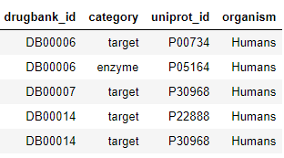
File Details
Drugs: Drug Bank
Process
- Use XML parser to extract, small molecule drugs, synonyms & Target Proteins
Challenges / Solutions
- Large database
- Non-Standard XML
- Mapped available tables
Chemical structure
Target
Pathways
Drug Interactions
Food Interactions
…
Future Steps
- Extract additional Drug attributes
Some attributes need to be extracted from text
- Proteins may need to be revisited
- Synonyms need to be revisited
(Implications for matching to Truth)
Source URL: https://go.drugbank.com/releases/latest
1. DrugBank Proteins
<DBID>
<UniProtID>
1. DrugBank
SMDrugs
<DBID>
1. DrugBank
Synonyms
<DBID>
<Drug Name>
DBID
DBID
drugbank_id | Name | inchi | groups | atc_codes | categories | truth
DB00006 | Bivalirudin | InChI=1S/C98H138N24O33/c1-5-52(4)82(96(153)122... | approved|investigational | B01AE06 | Amino Acids, Peptides, and Proteins|Anticoagul... | 0.0
DB00007 | Leuprolide | InChI=1S/C59H84N16O12/c1-6-63-57(86)48-14-10-2... | approved|investigational | L02AE51|L02AE02 | Adrenal Cortex Hormones|Agents Causing Muscle ... | 0.0

Slide 6
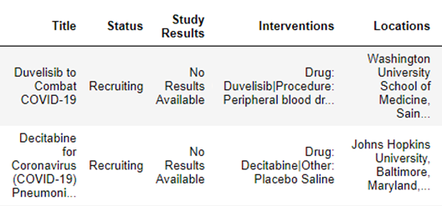
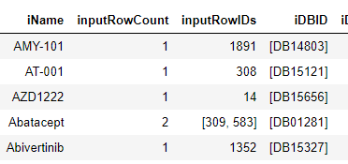
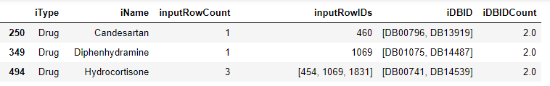
File Details
Truth: Clinical Trials
Process
Extract small molecule drugs from text and match to drugbank synonyms
Challenges / Solutions
Parse intervention type(s) from description
Parse intervention(s) from description
Mis spellings
Extra words
Multiple names per group
Wrong intervention type
Added override table
Future Steps
Complete Integration feedback loop
iNames mapping to 2+ DBIDs
Could parse out status, etc.
Source URL: https://clinicaltrials.gov/ct2/results?cond=COVID-19
2. Truth
Clinical Trials
<Drug Name>

Slide 7
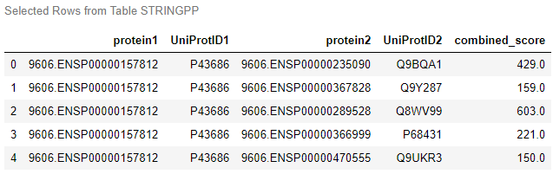

File Details
Protein-Protein Interactions: STRING
Source URL: https://string-db.org/cgi/download?sessionId=blXUTlQ4pHMK
Process
Relationships are shown both directions
ID1 -> ID2 400
ID2 -> ID1 400
map STRING / UNIProt 1:1
Challenges / Solutions
STRINGID 1.5% not macthed
-EnsemblePro reduced to 0.2%
Future Steps
- Depricated Ensemble Pro IDs
3. String PPInteraction
<StringID>
Example of a deprecated STRING ID 9606.ESPN00000195455

Slide 8
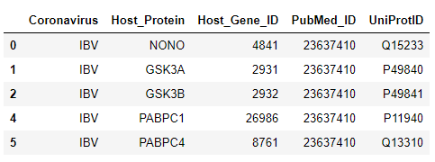

File Details
Virus Host Proteins: Gordon, D.E. et al. (2020) A SARS-CoV-2 protein interaction map reveals targets for drug repurposing. Nature 583(7816):459-468
Source URL: https://www.ncbi.nlm.nih.gov/sars-cov-2/
Process
Map coronavirus to uniport ID
Challenges / Solutions
Merge with Gene_ID in UniProt
Multiple matches
Exclude A0A
Select P over Q
Future Steps
How to handle prefixes other than P, Q and A0A
4. Virus HostProtein
<GeneID>
HCoV-associated host proteins.csv

Slide 9
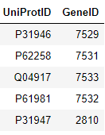
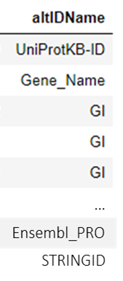
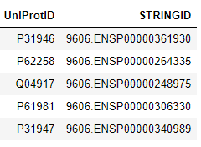
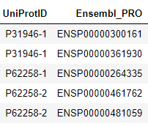
File Details
Protein/Gene cross reference: UniProt
Source URL:
https://ftp.uniprot.org/pub/databases/uniprot/current_release/knowledgebase/idmapping/by_organism/
Process
Extract mapings to UniProt for alternate protein identifiers
GeneID + GeneName
StringID + EnsemblPro (+deprecated)
Challenges / solutions
Started with manual process
Found source data
Full file does not load
Future Steps
GeneID -> UniProt maps to multiple rows
Multiple other IDs available if needed
5. Uniprot GeneID*
<UniProtID>
<GeneID>
5. Uniprot StringID*
<UniProID>
<StringID>

Slide 10
GNBR

Slide 11
Data Preprocessing Steps
8 .txt files uploaded to our shared image from original source
Data Pulled From Source
Data pulled from server, codes relabeled, data uploaded to a Caslib
GNBRDataImport.sas
Dependency Path cleansing, Gene ID parsing
GNBRDataCleansing.sas
GNBR datasets integrated, Dendrograms mapped to ground truth
GNBRDataIntegration.sas
Take the ground truth DB IDs (GeneIDs) to integrate to Uniprot bridge table
GNBRDataIntegrationDrugBank.sas
Need to map Chemical Disease Dendrogram, further mapping at request of modeling team
Future data mapping

Slide 12
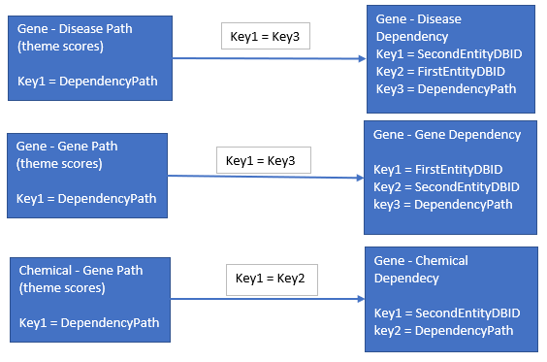
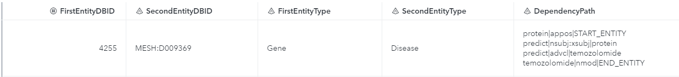
Path – Dependency Integration
Relationship: 1 to 1
ID: Dependency Path (Varchar)
Process:
Convert Dependency path to varchar then do a FedSQL/merge join
Challenges:
May run into issues
with memory and joining
on a string variable
Gene – Disease Dependency
Gene – Disease Path

Slide 13
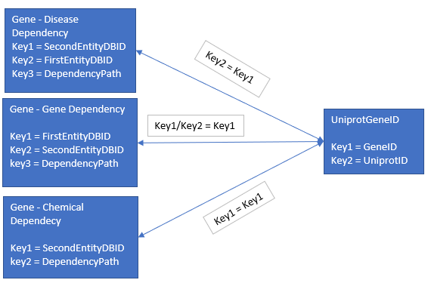
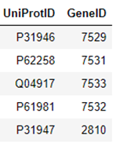
GNBR – Uniprot Integration
Relationship: Many to 1, 1 to Many
ID: GeneID (integer)
Process:
Parse GeneID and taxonomy from SecondEntityDBID
Convert SecondEntity to numeric
Run merge or FedSQL join
Challenges:
Uniprot proteins have many genes
Dependency
datasets have
multiple instances
of the same geneID
Data cleansing Issues
Gene – Disease
Uniprot

Slide 14
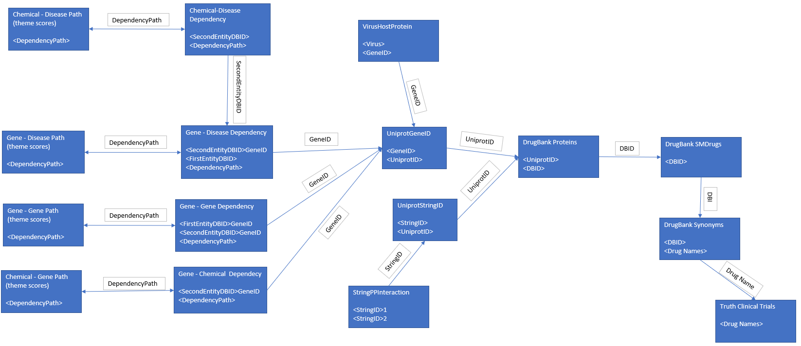
Final ERD

